Slide 1


Green Pace
Security Policy Presentation
Developer: Andrew Fisher

Slide 2

OVERVIEW: DEFENSE IN DEPTH
Green Pace Security Policy
Creates consistent security rules for all developers.
Addresses coding vulnerabilities before software is released.
Uses secure coding standards, testing, encryption, and access controls.
Supports defense in depth by using multiple layers of protection.

Slide 3
THREATS MATRIX
Likely STD-002, 003, 004, 005, 008, 010 | Priority STD-001, 002, 003, 004, 005, 008, 010
Low priority STD-006, 009 | Unlikely STD-001, 006, 009
Most of the higher-priority risks are also considered likely to happen. These include problems like SQL injection, unsafe memory use, string handling issues, and invalid container access. STD-007 is rated Probable with Medium priority, so it does not fit directly into one of the four categories shown.

Slide 4
10 PRINCIPLES
Validate Input Data — STD-001, 002, 003, 004, 008
Heed Compiler Warnings — STD-001, 002, 006
Architect and Design for Security Policies — No direct coding standard
Keep It Simple — STD-007
Default Deny — No direct coding standard
Principle of Least Privilege — No direct coding standard
Sanitize Data Sent to Other Systems — STD-004
Practice Defense in Depth — No direct coding standard
Use Effective Quality Assurance Techniques — STD-003, 005, 006, 007, 008, 009, 010
Adopt a Secure Coding Standard — STD-001 through STD-010

Slide 5
CODING STANDARDS
Coding Standards
STD-001 — Integer conversions
STD-002 — Signed integer overflow
STD-003 — String storage
STD-004 — SQL injection
STD-005 — Freed memory
STD-006 — Assertions
STD-007 — Exception handling
STD-008 — Container access
STD-009 — File handling
STD-010 — Memory deallocation
Risk Ranking
High Priority: STD-001, 002, 003, 004, 005, 008, 010
Medium Priority: STD-007
Low Priority: STD-006, 009

Slide 6
ENCRYPTION POLICIES
In Flight
Protects data while being transmitted
Green Pace must use TLS 1.3 or greater
Applies to sensitive data sent between users, applications, and systems
At Rest
Protects stored data
Green Pace must use AES-256 or stronger
Applies to databases, files, and backups
In Use
Protects data while it is being processed
Sensitive data must be processed within a Trusted Execution Environment (TEE)
Limits exposure while data is active in memory

Slide 7
TRIPLE-A POLICIES
Authentication
Verifies a user’s identity before access is granted
Green Pace must require unique credentials
Multi-factor authentication must be used for sensitive systems
Authorization
Controls what an authenticated user can access
Green Pace must use Role-Based Access Control (RBAC)
Access must follow the principle of least privilege
Accounting
Records important user and system activity
Green Pace must log logins, access changes, and sensitive actions
Logs support audits and security investigations

Slide 8
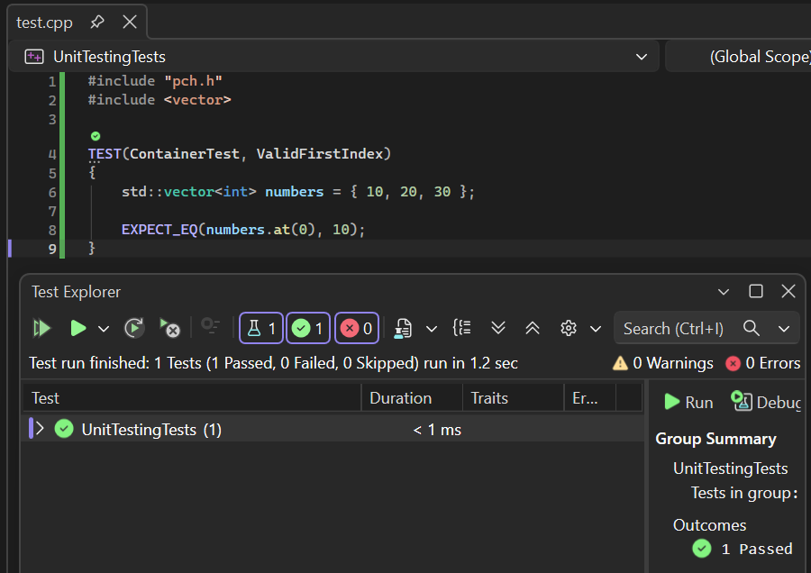
Does a valid first index return the correct value?
Vulnerability:
STD-008
Container Access
Test Type:
Positive Test
Result: PASS

Slide 9
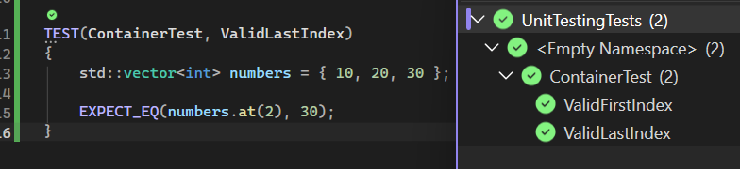
Does a valid last index return the correct value?
Vulnerability:
STD-008
Container Access
Test Type:
Positive Test
Result: PASS

Slide 10
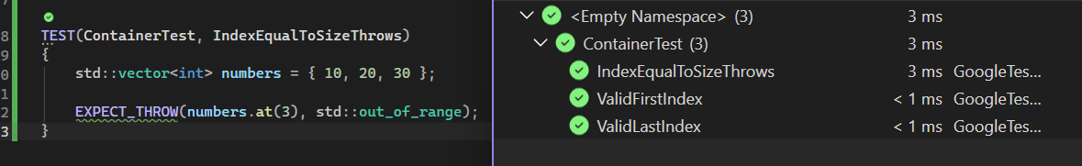
Does an index equal to the vector size throw an exception?
Vulnerability:
STD-008
Container Access
Test Type:
Negative Test
Result: PASS

Slide 11
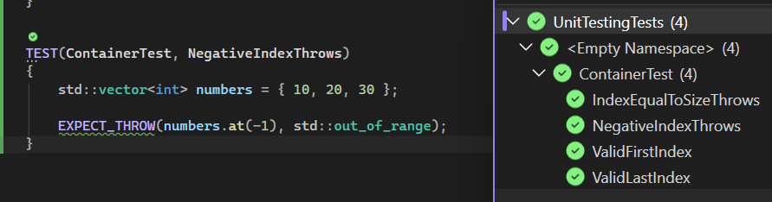
Does a negative index throw an exception?
Vulnerability:
STD-008
Container Access
Test Type:
Negative Test
Result: PASS

Slide 12
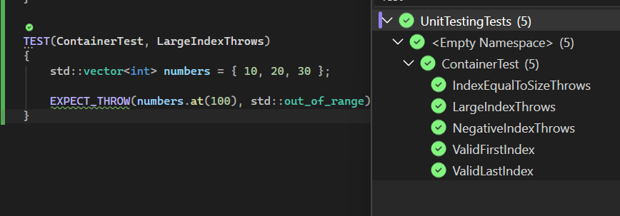
Does a very large index throw an exception?
Vulnerability:
STD-008
Container Access
Test Type:
Negative Test
Result: PASS

Slide 13

AUTOMATION SUMMARY

Slide 14
TOOLS
Tools
Cppcheck — Build / Verify & Test — static code analysis
Parasoft C/C++test — Build / Verify & Test — checks CERT coding standards
Clang Static Analyzer — Verify & Test — detects memory problems
Google Test — Verify & Test — automated unit testing
LDAP / Active Directory — Production — centralized authentication and access control

Slide 15
RISKS AND BENEFITS
Act Now
Find vulnerabilities earlier
Reduce the chance of larger security incidents
Make fixes cheaper and easier
Build security into normal development
Improve consistency across projects
Wait
Vulnerabilities may reach production
Fixes can become more expensive
Security gaps may affect more users or systems
Greater risk of data loss, downtime, or unauthorized access
More dependence on reacting after an incident
Remaining risk: Automation and testing reduce risk, but they cannot catch every vulnerability. Security controls still need regular review and updates.

Slide 16
RECOMMENDATIONS
Replace broad guidance with specific, enforceable requirements
Require TLS 1.3+ for data in flight
Require AES-256+ for sensitive data at rest
Use RBAC and least privilege for authorization
Add multiple automated security tools throughout DevSecOps
Review and update security standards as threats and tools change

Slide 17
CONCLUSIONS
Adopt secure coding standards across all development
Require MFA and stronger access controls
Use RBAC and least privilege
Continue automated testing, static analysis, and monitoring
Review security policies regularly
23andMe shows how one weakness can lead to much wider exposure

Slide 18
REFERENCES
Carnegie Mellon University Software Engineering Institute. (n.d.). SEI CERT C coding standard. https://cmu-sei.github.io/secure-coding-standards/sei-cert-c-coding-standard/
Carnegie Mellon University Software Engineering Institute. (n.d.). SEI CERT C++ coding standard. https://cmu-sei.github.io/secure-coding-standards/sei-cert-cpp-coding-standard/
Franceschi-Bicchierai, L. (2023, December 4). 23andMe confirms hackers stole ancestry data on 6.9 million users. TechCrunch. https://techcrunch.com/2023/12/04/23andme-confirms-hackers-stole-ancestry-data-on-6-9-million-users/
Franceschi-Bicchierai, L., & Whittaker, Z. (2023, December 1). 23andMe says hackers accessed ‘significant number’ of files about users’ ancestry. TechCrunch. https://techcrunch.com/2023/12/01/23andme-says-hackers-accessed-significant-number-of-files-about-users-ancestry/

